Slide 1

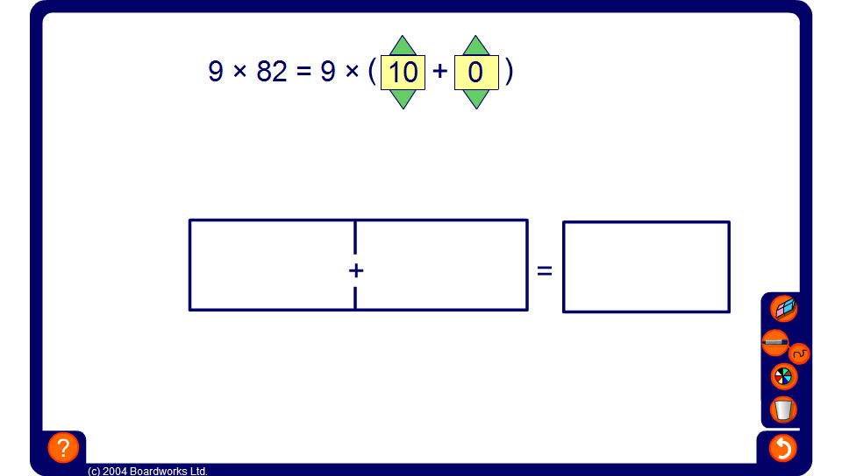


Using a grid to multiply
Notes:
Use this grid to demonstrate the use of the distributive law to multiply single-digit whole numbers by two-digit whole numbers.
Stress to pupils that these calculations should be done mentally (using jottings if required). The grid is used here for practice and to aid visualisation.
There are two ways to solve each problem. Either the two-digit number can be divided into tens and units which are added together or it can be rounded to the nearest ten with the amount that has been added on subtracted. Notice that clicking on the plus sign changes it to a minus sign.
Discuss which of these methods is best for each problem.
Point out that because it is often usually easier to add than to subtract we usually only use the second of these methods for two-digit numbers that end in 8 or 9. This avoids having to subtract larger numbers to obtain the solution.

